Slide 1

Workshop for Economic Modeling in Julia
Y.-H. Henry Chen
Research Scientist, MIT CS3
Feb 3, 2026

Slide 2
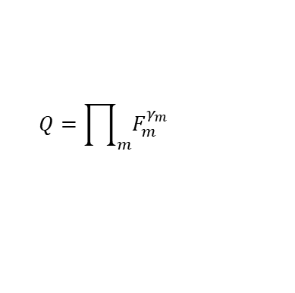



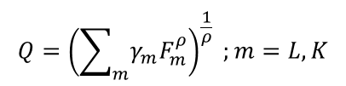









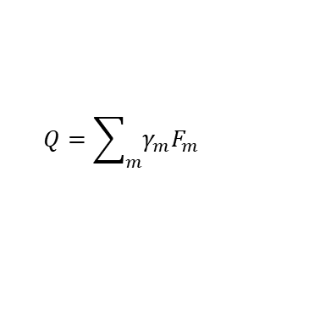
Production technology
Constant elasticity of substitution (CES) function
X: 100
K
$$σ$$
L: 25
K: 75
75
X=100; $σ=0$
$$σ≡[\frac{d\left(\frac{F_{l}}{F_{k}}\right)}{\left(\frac{F_{l}}{F_{k}}\right)}]/[\frac{d\left(\frac{P_{k}}{P_{l}}\right)}{\left(\frac{P_{k}}{P_{l}}\right)}]=\frac{1}{1−ρ}$$
X=100; $σ=0.5$
X=100; $σ=1$
X=100; $σ=∞$
$γ_{m}$: cost share
$$Q=\sum_{m}{γ_{m}F_{m}}$$
$$σ=∞$$
25
L
$$Q={\left(\sum_{m}{γ_{m}F_{m}^{ρ}}\right)}^{\frac{1}{ρ}} ;m=L, K$$
$σ>0$; $σ≠1$
$$Q=\prod_{m}{F_{m}^{γ_{m}}}$$
$$σ=1$$
$$Q=\min{[γ_{1}F_{1}, { γ}_{2}F_{2}, …,γ_{m}F_{m}]}$$
$$σ=0$$

Slide 3
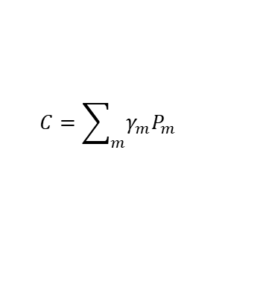

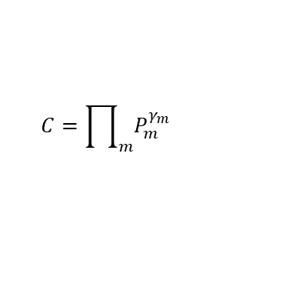

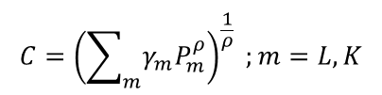



Production technology
Duality theorem: production function => cost function
C: 1
PK
$$σ$$
PL: 1
PK: 1
1
C=1; $σ=0$
$$σ≡[\frac{d\left(\frac{F_{l}}{F_{k}}\right)}{\left(\frac{F_{l}}{F_{k}}\right)}]/[\frac{d\left(\frac{P_{k}}{P_{l}}\right)}{\left(\frac{P_{k}}{P_{l}}\right)}]=\frac{1}{1−ρ}$$
C=1; $σ=0.5$
C=1; $σ=1$
C=1; $σ=∞$
$γ_{m}$: cost share
$$C=\sum_{m}{γ_{m}P_{m}}$$
$$σ=∞$$
1
PL
$$C={\left(\sum_{m}{γ_{m}P_{m}^{ρ}}\right)}^{\frac{1}{ρ}} ;m=L, K$$
$σ>0$; $σ≠1$
$$C=\prod_{m}{P_{m}^{γ_{m}}}$$
$$σ=1$$
$$C=\min{[γ_{1}P_{1}, { γ}_{2}P_{2}, …,γ_{m}P_{m}]}$$
$$σ=0$$

Slide 4
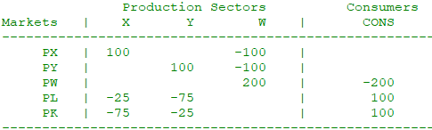
Social Accounting Matrix
M21_mcp.gms; M21.gms (Markusen, 2002)
Summarizing the input-output structure of an economy

Slide 5
Social Accounting Matrix
Zero-profit condition for X : MC-MR >= 0 ; Q >= 0 ; (MC-MR)*Q = 0 ; No need to worry about MC-MR < 0 (Why?)

Slide 6
Social Accounting Matrix
Market clearing condition for X : S-D >= 0 ; P >= 0 ; (S-D)*P = 0 ; No need to worry about S-D < 0 (why?)
Zero-profit condition for X : MC-MR >= 0 ; Q >= 0 ; (MC-MR)*Q = 0 ; No need to worry about MC-MR < 0 (Why?)

Slide 7
Social Accounting Matrix
Market clearing condition for X : S-D >= 0 ; P >= 0 ; (S-D)*P = 0 ; No need to worry about S-D < 0 (why?)
Income balance condition : Income = Expenditure
Zero-profit condition for X : MC-MR >= 0 ; Q >= 0 ; (MC-MR)*Q = 0 ; No need to worry about MC-MR < 0 (Why?)

Slide 8
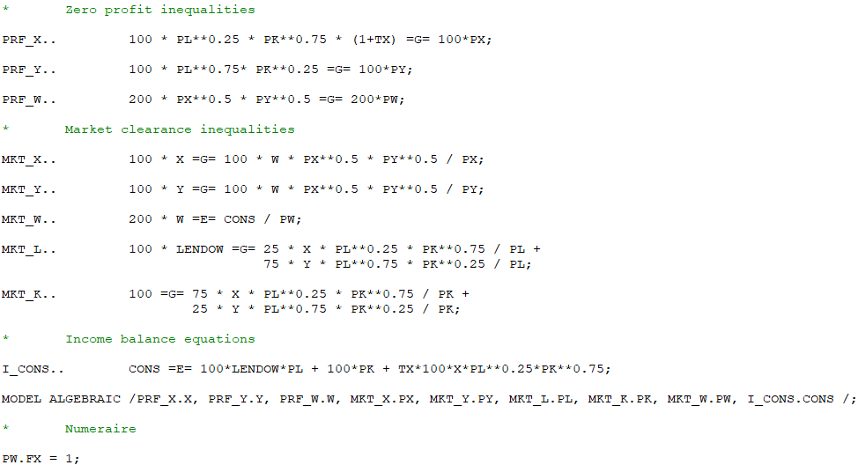
Model
An excerpt for M21_mcp.gms (Markusen, 2002)

Slide 9
Model
Let us check the Julia version: M21_mcp.jl
https://chenyhmitedu.github.io/docs/M21_mcp.jl

Slide 10
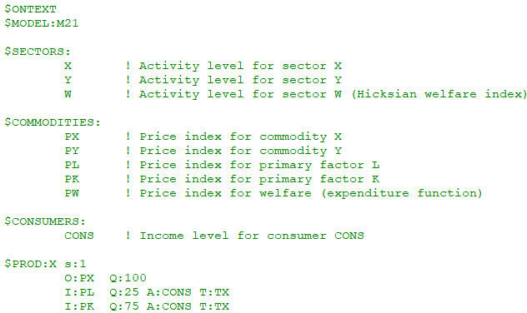
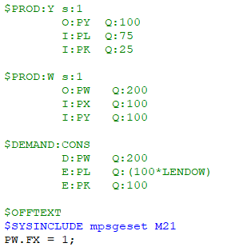
Model
An excerpt for M21.gms (Markusen, 2002)

Slide 11
Model
Let us check the Julia version: M21.jl
https://chenyhmitedu.github.io/docs/M21.jl

Slide 12
Project
For the two models, enhance code reusability and avoid repetition
  Sectors are stored in vectors
  SAM values are stored in dictionaries
  Replace numbers in code blocks by key-specified dictionaries

Slide 13
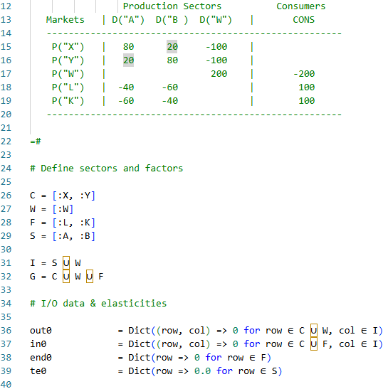
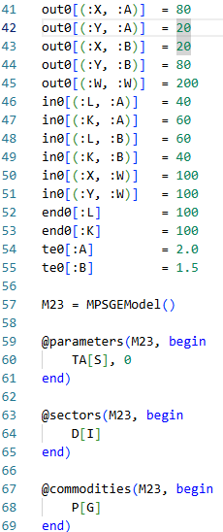
Project
Hint:

Slide 14
Bibliography
Markusen, J. (2002). General-Equilibrium Modeling using GAMS and MPS/GE: Some Basics. University of Colorado, Boulder. https://www.mpsge.org/tutorial.pdf
Rutherford, T. (2002). Lecture Notes on Constant Elasticity Functions. University of Colorado, Boulder. https:
//downloads.regulations.gov/EPA-HQ-OAR-2022-0730-0088/attachment_58.pdf

